Slide 1
Least Privilege Access
ACE-Security
Notes:
ACE-Security course is built by Shahzad Ali with the help from Joe and Rizwan from ACE Team.
For comments, please reach out to shahzad@aviatrix.com for comments or improvements.

Slide 2
Least Privilege Access
Tenet from NIST Publication 800-207 - Zero Trust Architecture (ZTA)
Trust in the requester is evaluated before the access is granted. Access should also be granted with the least privileges needed to complete the task.
Trust no one, not even internal services, resources, and actors
User VPN
RBAC
Parameter security solutions not sufficient (lateral movement)

Slide 3
RBAC

Slide 4
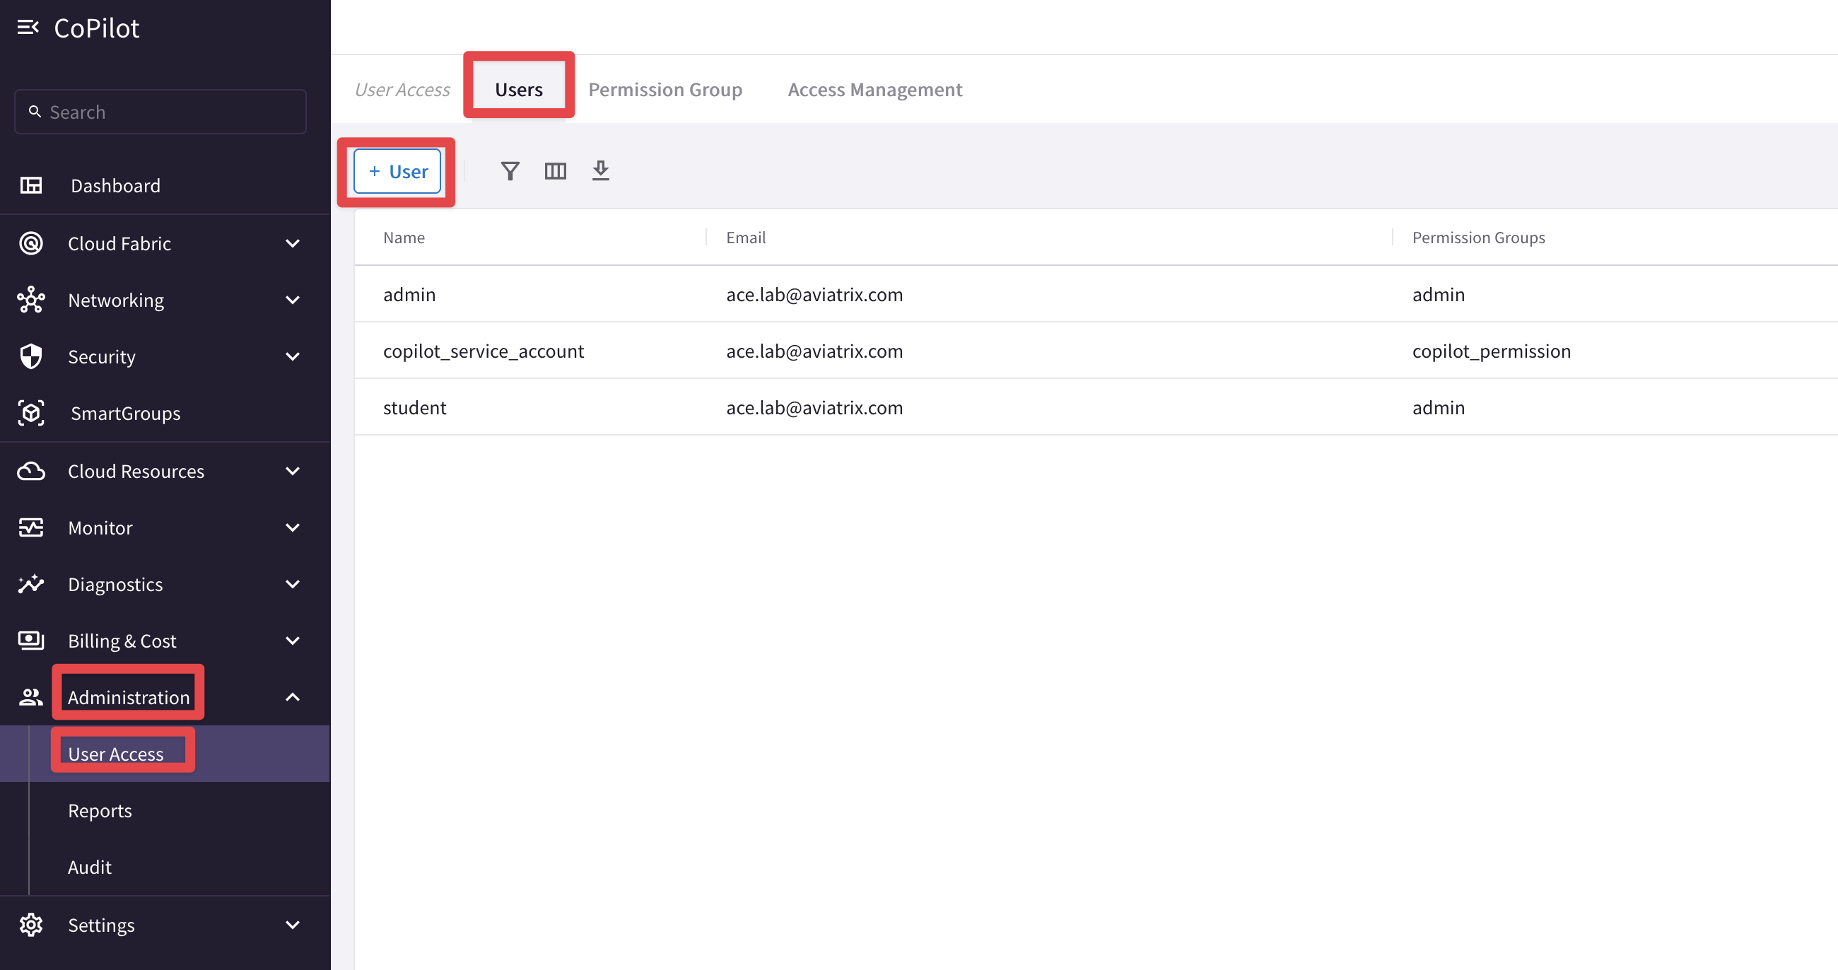
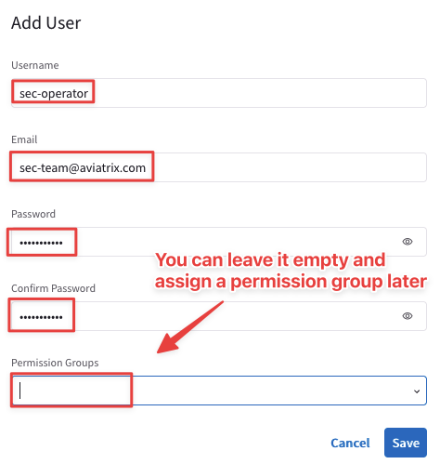
User Access- CoPilot

Slide 5
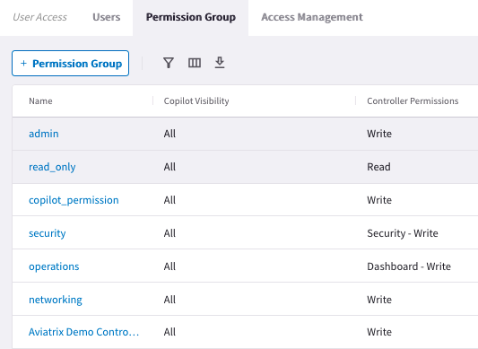
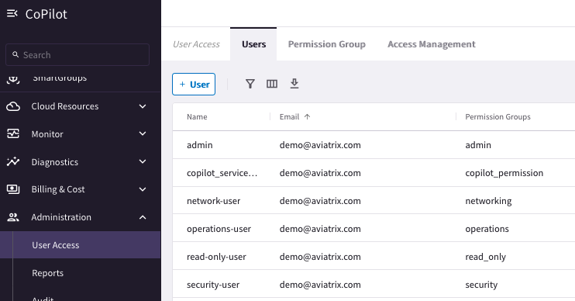
Aviatrix RBAC Control

Slide 6
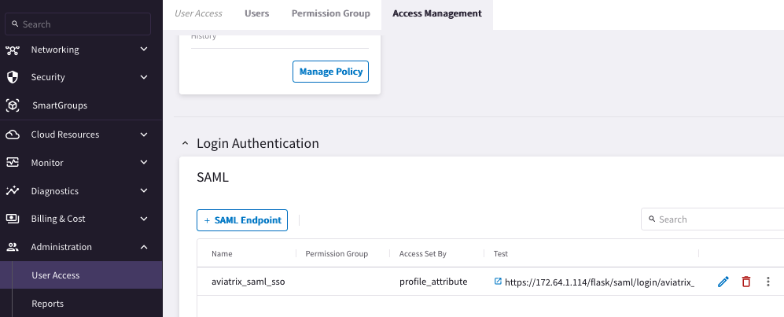



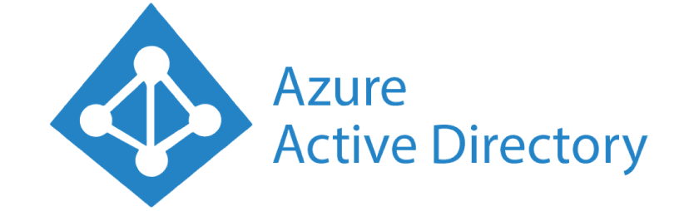



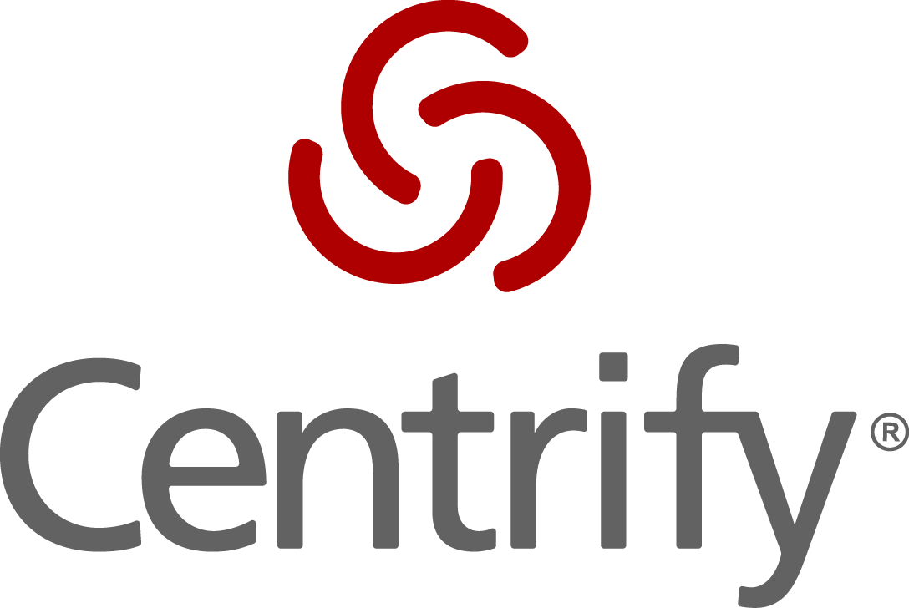
Authentication
Users can be authenticated Locally or using SAML IDP
AWS SSO

Slide 7
Aviatrix User VPN

Slide 8
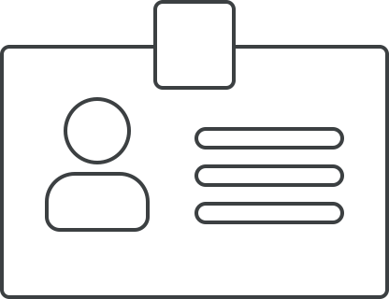










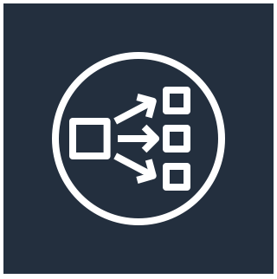

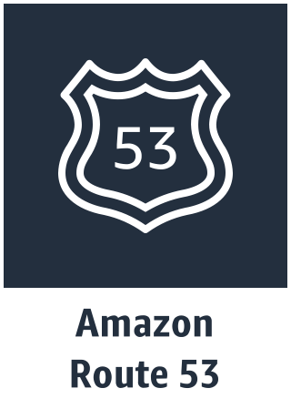

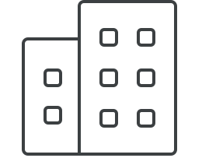



Least Privilege Access for Developer – Aviatrix User VPN
Enterprise
Identity Providers
SAML
VPCs
GCP
Profiles
VPC
VPC
Partners
VPN VPC
OpenVPN
Contractors
NLB
Transit VPC
Employees
Transit VNet
VNets
Remote Users
Aviatrix
Controller
Geo VPN
User Accelerator
Azure
Data Center
Notes:
Centralized management and visibility by controller
Cloud-native: Aviatrix gateways, orchestration of cloud routing, NLB management
Profiles
OpenVPN: any OpenVPN client is supported. We also have our own Aviatrix client to simplify SAML integration.
SAML IDP integration
Same architecture across any cloud type
Can be used to connect back to on-prem as well. Called Site2Cloud connection in Aviatrix. We can exchange routes between the two.
Geo VPN: you deploy your GWs in different geographical location (e.g. US East, Europe Central, Asia Southeast), and your users can use the same configuration file to connect one of these setups, the one which provides the best connectivity for them. W/o it, the cert is tied to a NLB in a region. With it, you have a hosted domain in Route 53 and register route targets that are the NLBs with Latency Based Routing. When you do a DNS query, you are returned the target with the lowest latency. The user doesn’t need to change anything on their VPN client when moving because according to cert, they land on NLB.
With Geo VPN, traffic from user to Aviatrix gateways is still going over the public Internet. This can be optimized even more. Because Aviatrix also integrates with AWS Global Accelerator. Global Accelerator is using the large number of AWS edge locations around the world. It’s routing the traffic to the closest edge location into the AWS backbone. So you get a low latency and a predictable performance. OVPN Cert config: land on Global Accelerator entry point.

Slide 9
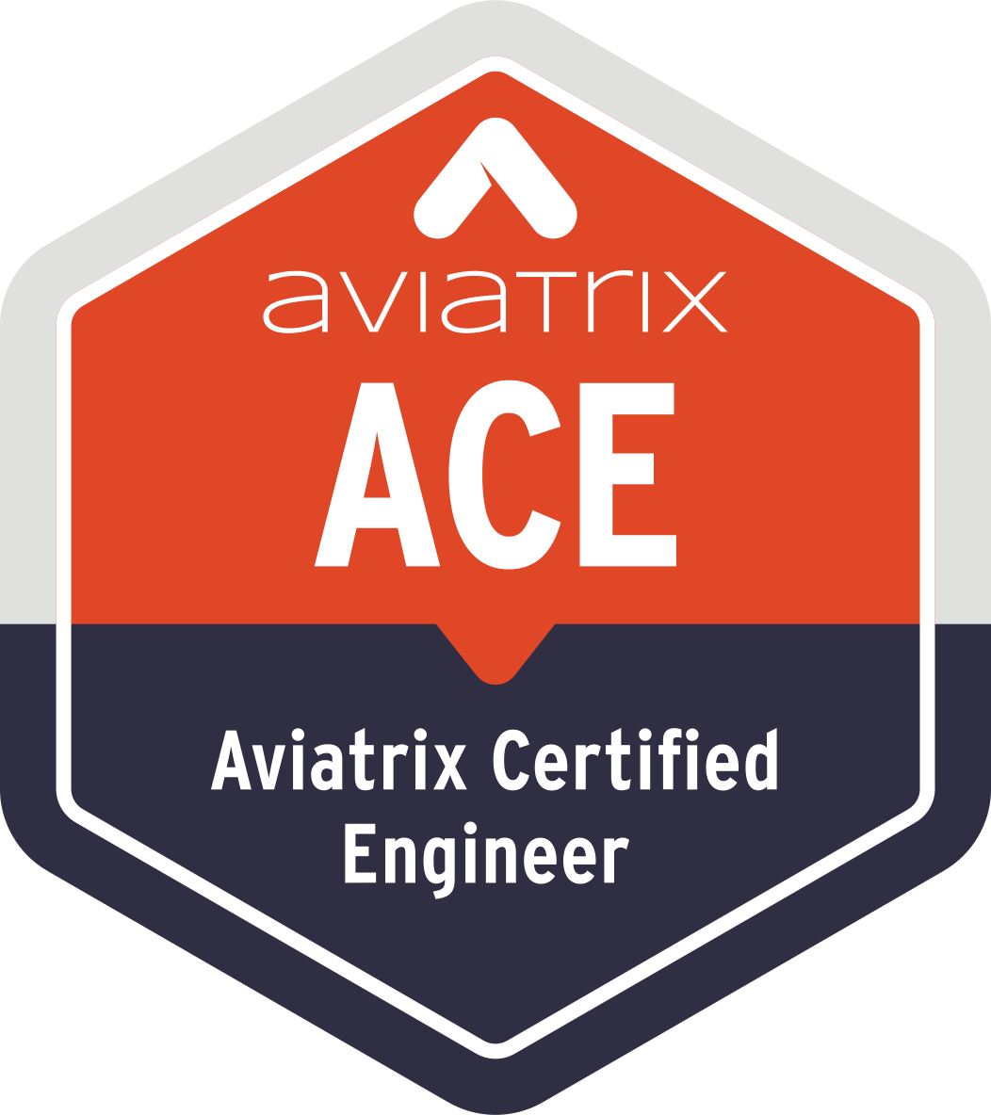

Aviatrix Certified Engineer (ACE)
COMMUNITY
https://aviatrix.com/ACE
https://community.aviatrix.com

Slide 10
RBAC: Role-Based Access Control
Admin
Role-Based Operator
Security
Transit
TGW
CloudWAN
Peering
Site2Cloud
VPN
Tools
Operations

Slide 12
Secure Routing Controls

Slide 13





BGP Route Approval
Can explicitly approve any BGP-learned route from Partner or on-prem into the cloud network
Prevents unwanted advertisement of routes such as 0/0
New routes arrive at Aviatrix Transit Gateway
Transit Gateway reports new routes to Controller
Controller notifies admin via email
Admin accesses the Controller to approve
If approved, Controller programs the new routes to gateways in all Spoke VPC/VNets
Spoke
VPC/VNet
Spoke
VPC/VNet
5
Transit VPC/VNet
Aviatrix Controller
2
3
4
1
Partner

Slide 14
